Slide 1
WebAssembly
Lecturer: Ngo Huy Bien
Software Engineering Department
Faculty of Information Technology
VNUHCM - University of Science
Ho Chi Minh City, Vietnam
nhbien@fit.hcmus.edu.vn

Slide 2

Objectives

Slide 3

Contents

Slide 4

References

Slide 5
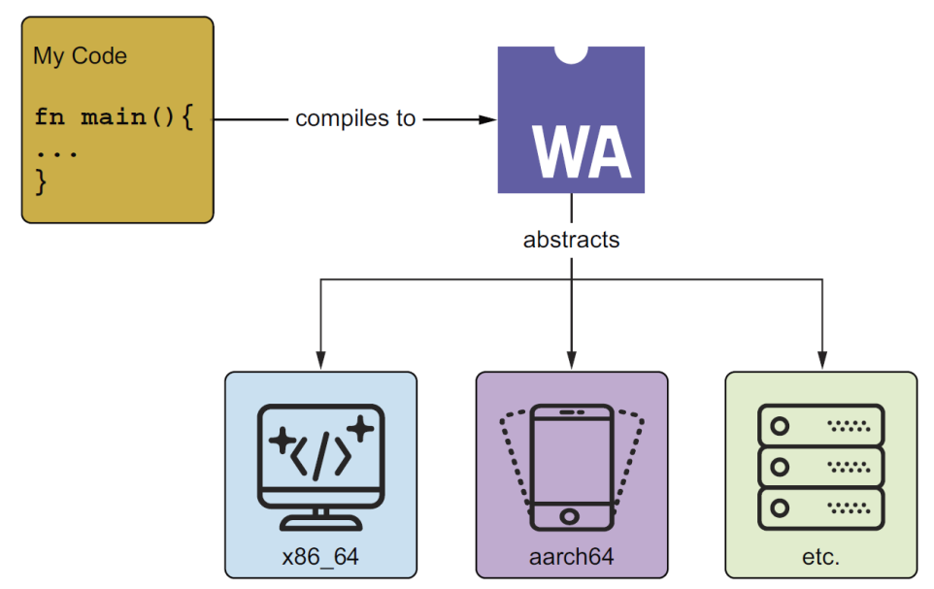
What is WebAssembly?
WebAssembly, commonly abbreviated as Wasm, is a construct that is akin to an instruction set architecture (ISA) like x86_64, aarch64 (also known as arm64), and others.
In the same way you can compile your code to such architectures, you can compile your code to Wasm.
Wasm as an abstraction layer
virtualizing over various kinds of hardware

Slide 6
Why WebAssembly? (I)
It was created to meet the performance demand for increasingly hard computational tasks that people wanted to run in the browser, like 3D applications, audio and video software, and games, which JavaScript (i.e., the web’s only universally supported native programming language) could not handle due to its inconsistent performance and various other pitfalls.
Unlike earlier attempts, such as Java applets—which also aimed to bring high-performance code to the browser but struggled with security vulnerabilities, plugin dependencies, and, still, inconsistent performance—Wasm offers a modern solution.

Slide 7
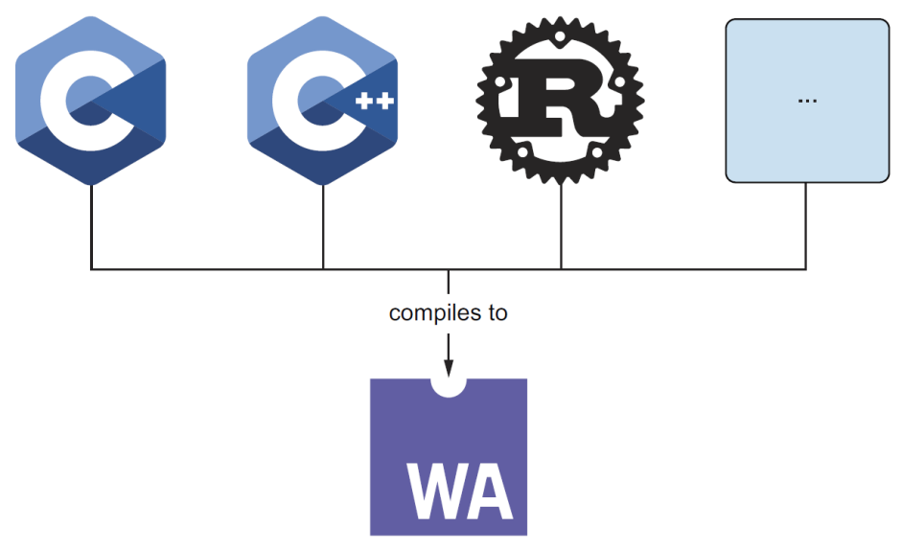
Why WebAssembly? (II)
As a W3C standard, Wasm is an official language of the web, alongside JS, HTML, and CSS. To address the web’s performance challenges, Wasm was designed to let developers compile code written in high-performance languages like C, C++, Rust, and others to run safely in the browser at near-native speeds.

Slide 8
Server-Side WebAssembly
In 2019, the WebAssembly System Interface (WASI) was released.
It defined an interface that Wasm runtimes can implement to enable Wasm to communicate with an operating system (OS) and run outside the web.
In a browser, Wasm relies on the browser itself as its environment; outside the browser, a Wasm runtime—often referred to as a host—serves the same role, providing the necessary system interactions.

Slide 9
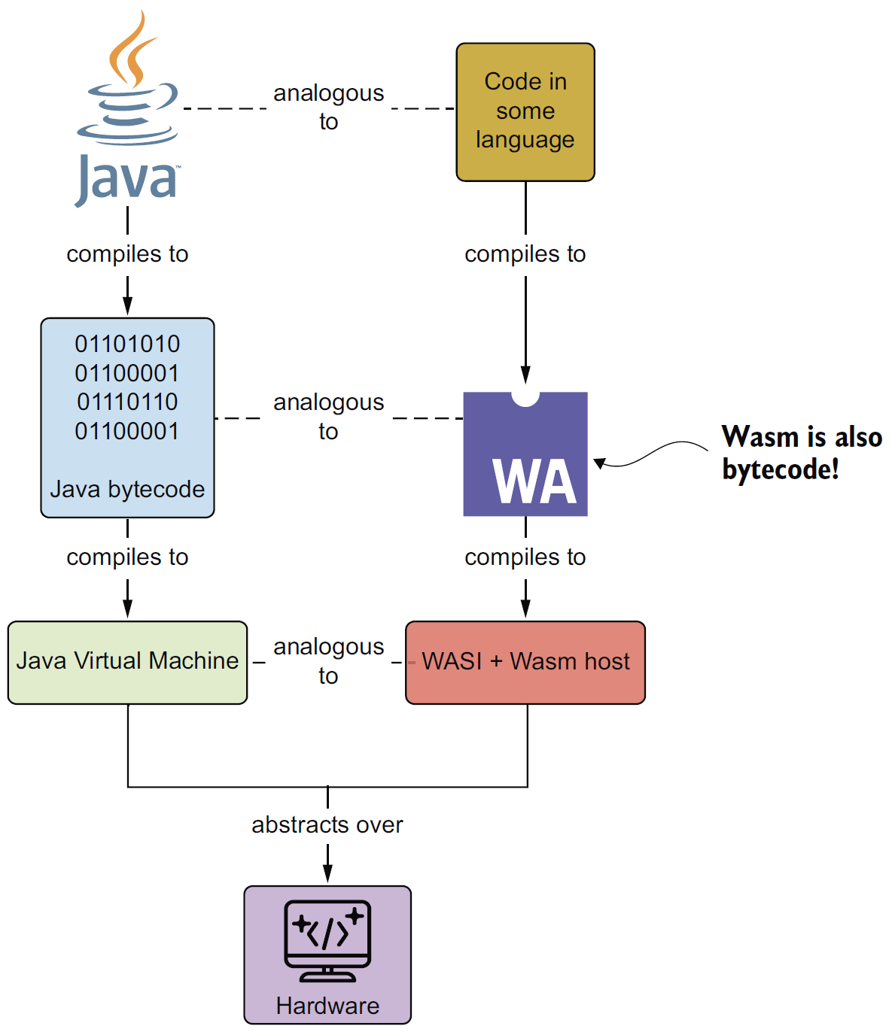
Java and Wasm
Unlike the JVM, which requires a heavyweight VM, Wasm’s design avoids the need for a complex execution environment.
Wasm is an open standard developed through the W3C with multivendor collaboration; it is not controlled by any single company.

Slide 10
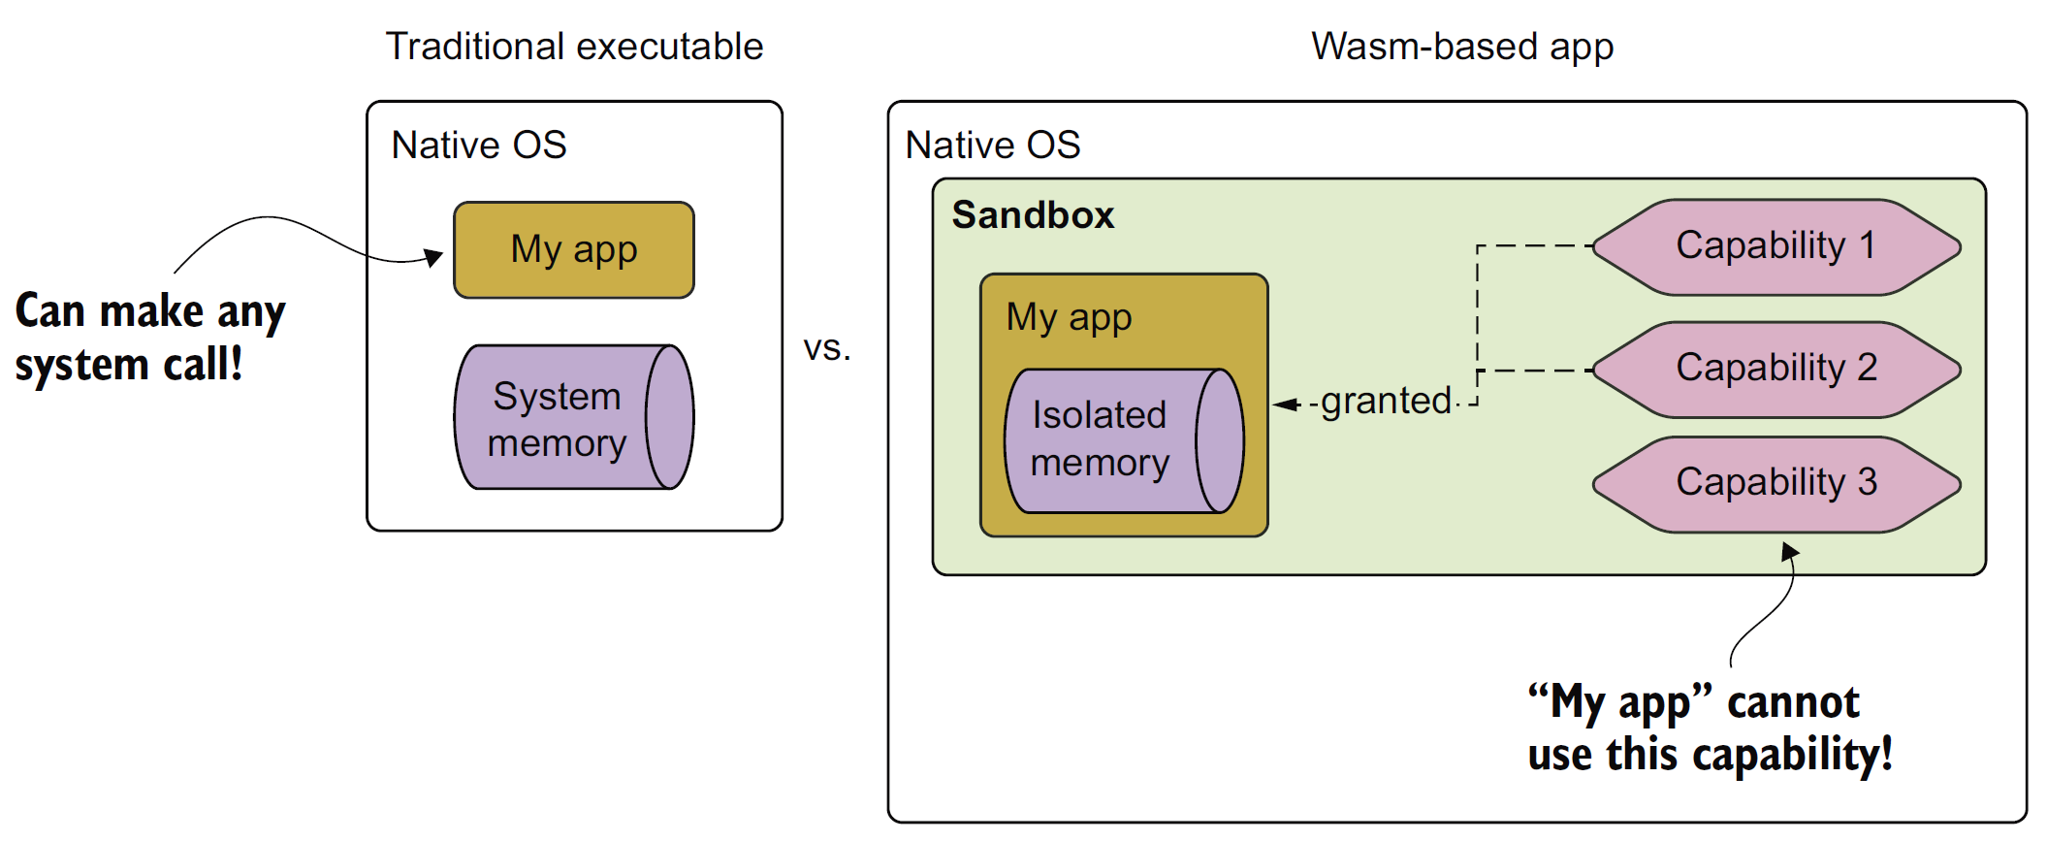
Security Model
A native (traditional) application security model versus Wasm’s capability-based security model.

Slide 11

Thank You & See You Again

